Slide 1

Forecasting number of airline passengers based on historical data
By Rohan Thampi

Slide 2
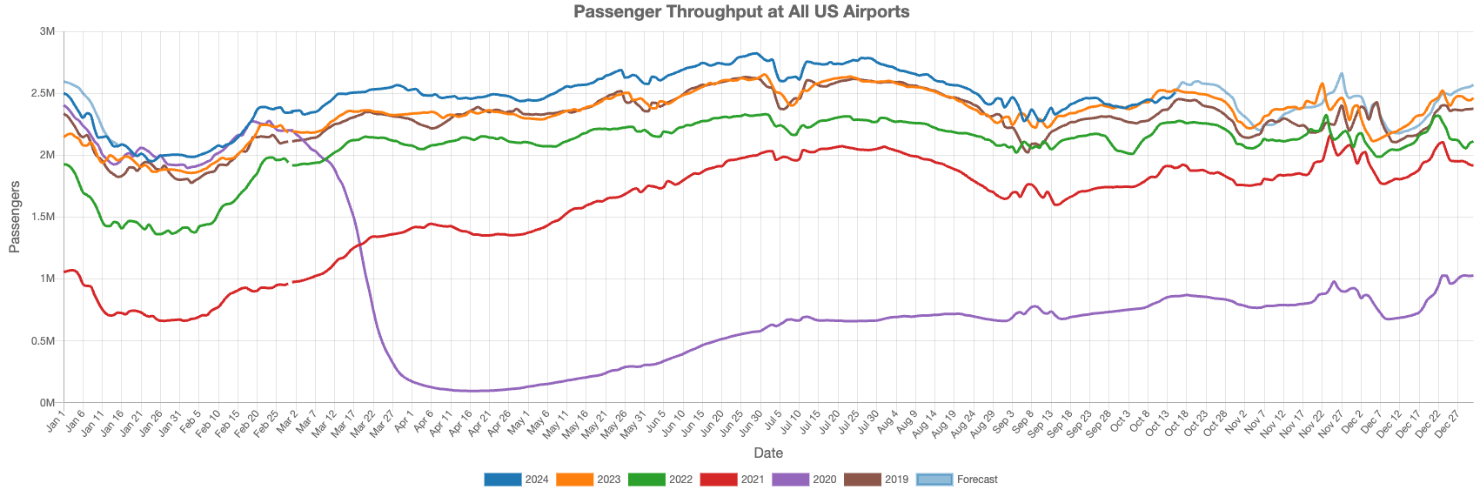
Background
Popularity of air travel
Number of passengers
… But very variable over time
https://flightbi.com/us-commercial-airport-traffic-in-september-2024/

Slide 3






Background
What is the problem –
Accurately predict the number of passengers at a particular point in time
Who does the solution benefit – AIRLINES!
What is the benefit –
Better financial planning
Understanding manpower requirement
Improve airport services and reduce risks

Slide 4




How to approach the problem
Supervised learning – influencing factors are hard to determine (demography, geography, behavioral, economic,etc) - need complex Neural Networks.
Time series – simpler models that only need historical time series data.
Data:
Air Passengers - https://www.kaggle.com/datasets/rakannimer/air-passengers
2 features – Number of passengers , month (1949 – 1960)

Slide 5
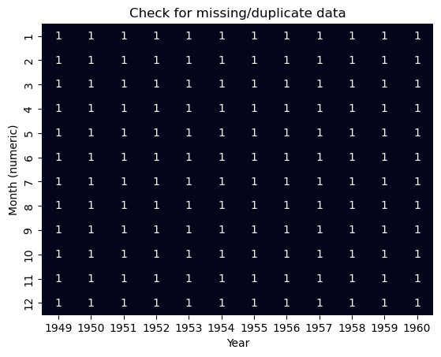
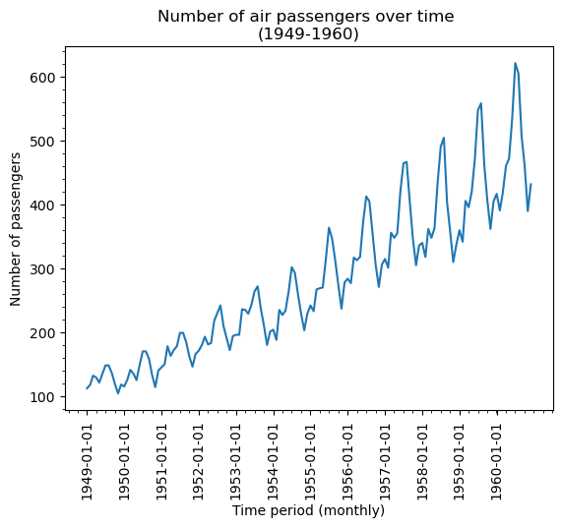
Data wrangling
No duplicates/missing data
No outliers
Legend for annotation:
0 = Data is absent (Missing data; Gaps in time series trend)
1 = Data present for the month
2 = Duplicate data identified

Slide 6
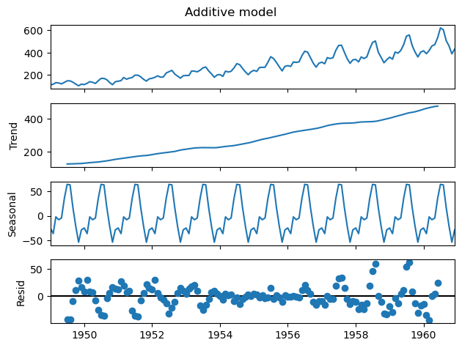
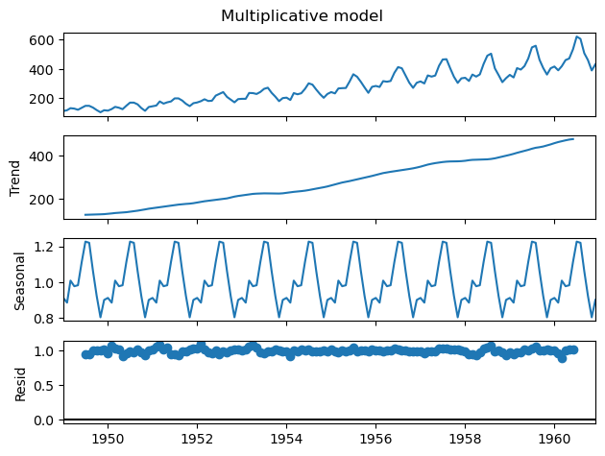
Data exploration
The additive models still leaves behind some trends in the residuals after decomposition. Thus multiplicative model was chosen for decomposition.

Slide 7
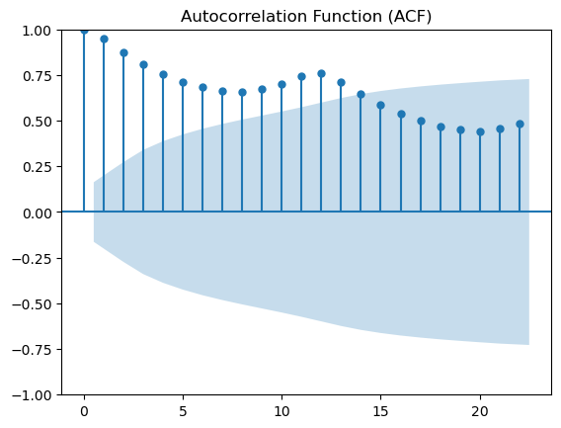
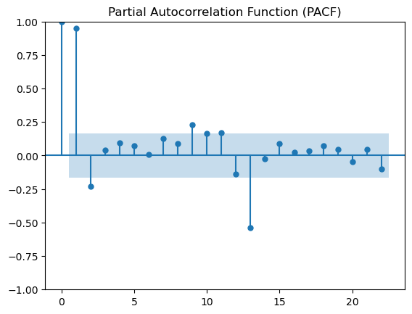
Data exploration
Gradual decline – long-term dependency (i.e. past values have a prolonged effect).
Many significant values – non -stationary
Likely requires AR(2) model (i.e. p=2).
Isolated significant values at certain lags (1, 2, 9 & 13) – important predictors for the current value.

Slide 8

Modelling

Slide 9
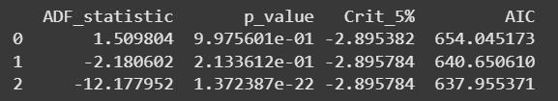
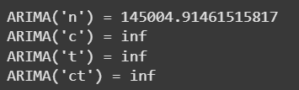
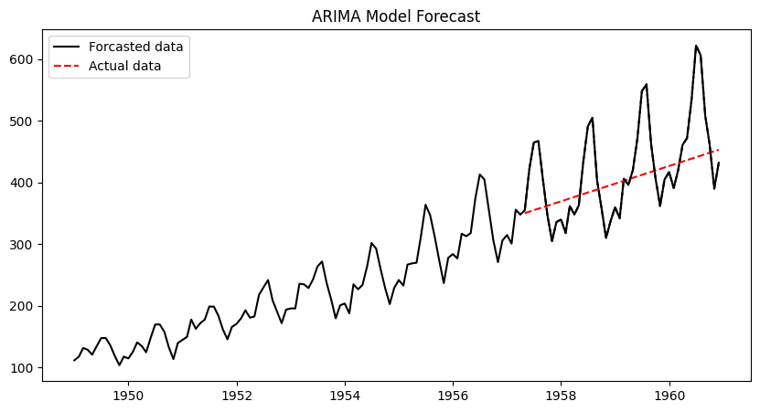
ARIMA
ADF test – Test for differencing order
Finding best order for ARIMA
Hyperparameter tested p & q – values [taking d = 1 or 2] (0, 2, 1) to give the best RMSE score
Trend parameter was found to have no impact
p-value for 1st order of differencing falls under 0.05 (95% CI).
Thus, at least a 1st order of differencing is required for data (or d=1 or higher)
RMSE = 69.965

Slide 10
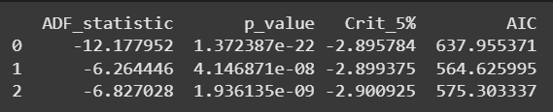
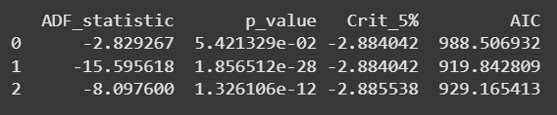

SARIMA
ADF test – Case 1 : d = 2
Case 2 : d = 1
p-value (D=0) < 0.05 (i.e Null hypothesis rejected & data is stationary). Thus for d=2, D=0 is acceptable
p-value (D=1) < 0.05 (i.e Null hypothesis rejected & data is stationary). Thus for d=1, D=1 is acceptable.
RMSE = 26.0940

Slide 11
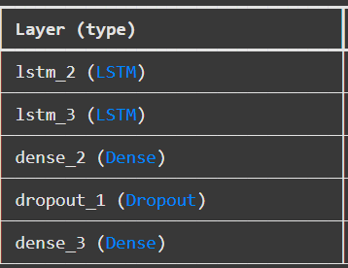

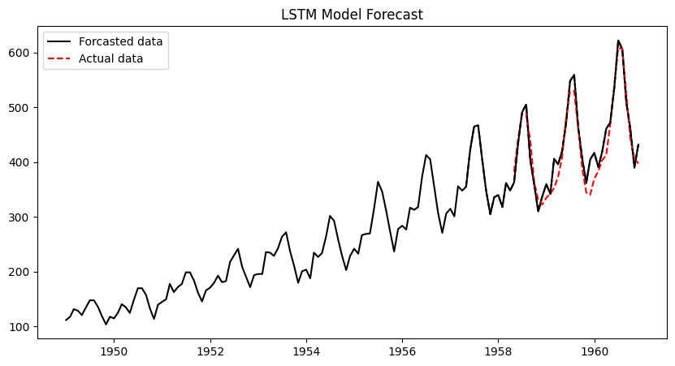
LSTM
Data reshaping:
the input layer expects a 3D array of data when fitting the model – (samples, time steps, features)
Create input – output pairs
Hyperparameter testing
RMSE = 25.04

Slide 12
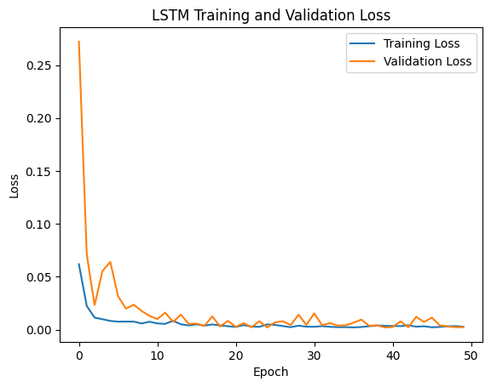

LSTM
The plot shows training and validation loss that decreases to a point of stability with a minimal gap between the two final loss values – indicates good fit

Slide 13


Comparison of models
RMSE = 69.965
RMSE = 26.0940
RMSE = 25.04

Slide 14
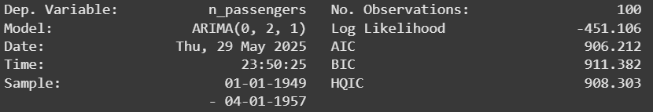
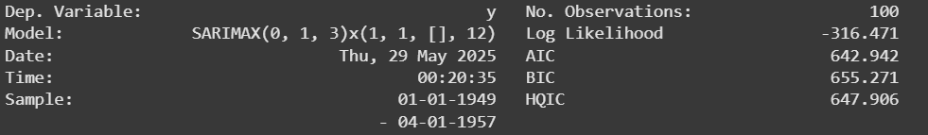
ARIMA & SARIMA – Performance metrics
ARIMA
SARIMA

